Slide 1
From https://twitter.com/alexgarcia_atx/status/1558097727497687040?t=lYHiqUIOB-lPUom7sS-qrw&s=03
1. Use Short Sentences
2. Cut Common Phrases
3. Replace Adjectives With Data
4. Eliminate Weasel Words
5. Use The "So-What" Test
6. Avoid Adverbs
7. Be Objective
8. Cut Acronyms and Jargon
9. Use Subject-Verb-Object Sentence structure

Slide 2
Academic Writing
Dirk Riehle, Univ. Erlangen
NYT C12
Licensed under CC BY 4.0 International

Slide 3
Agenda
The research paper
Sections of a research paper
Final research theses
Academic writing

Slide 4
1. The Research Paper

Slide 5
Research Papers
A research paper is
A scientific article published after passing peer review
Scientific peer review is
The review (assessment) of some artifact by scientific peers
The research paper is the gold standard of scientific publication

Slide 6
Other Types of Research Publications
Other types of research publications of varying quality
Public reviews
Monographies (books)
Presentation slides (lecturing)
Opinion pieces e.g. letters to the editor
The goal is public documented scientific exchange

Slide 7
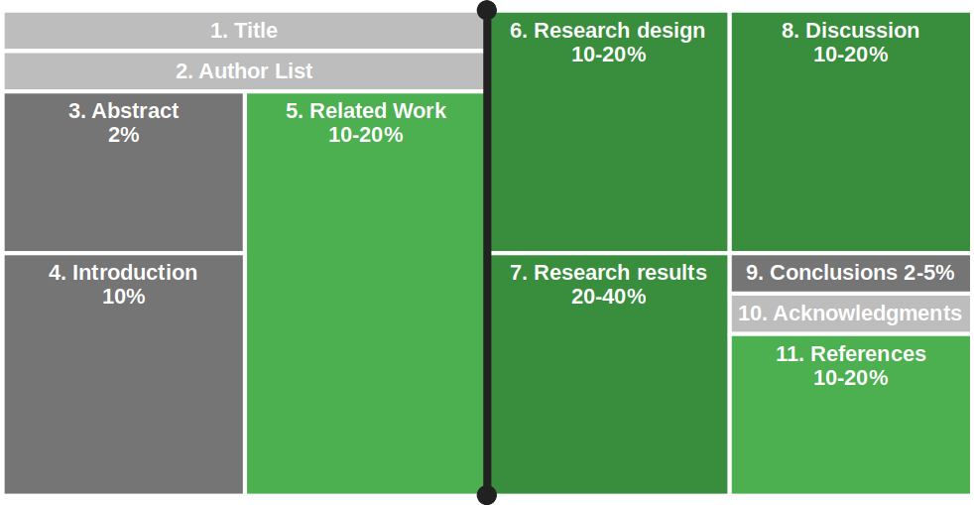
Structure of a Typical Research Paper

Slide 8
2. Sections of a Research Paper

Slide 9
1. Title
The purpose of a paper’s title is to
Attract readers
Indicate content
Good paper titles are
Context dependent (where will this be published)
Properly feed academic search engines

Slide 10
Best Practices for Paper Titles
Do
Raise reader interest
Be short and memorable
Carry a message
Indicate story
Don’t
Be long and academic
Be incomprehensible
Be overly cute

Slide 11
Examples of Paper Titles
Great title
“A rational design process: How and why to fake it”
Good title
“Nailing your thesis”
Poor title
“A comparative evaluation of common theories in computer science”

Slide 12
2. Author List
The purpose of the author list is to
Name and identify authors
Rank-order their contributions

Slide 13
Construction and Interpretation of Authors Lists
An author to a research paper must have made
A non-trivial intellectual contribution to the scientific content of the presented work;
Authors of other contributions go into the acknowledgement section
There is a logic to the author ordering
Minimum contribution gets you on
Ranking of contribution moves you up
Alphabetical ordering after that
Common patterns
Ph.D. student followed by supervising professor
First author followed by alphabetical list of other contributors
Principal investigator followed by alphabetical list of all project members

Slide 14
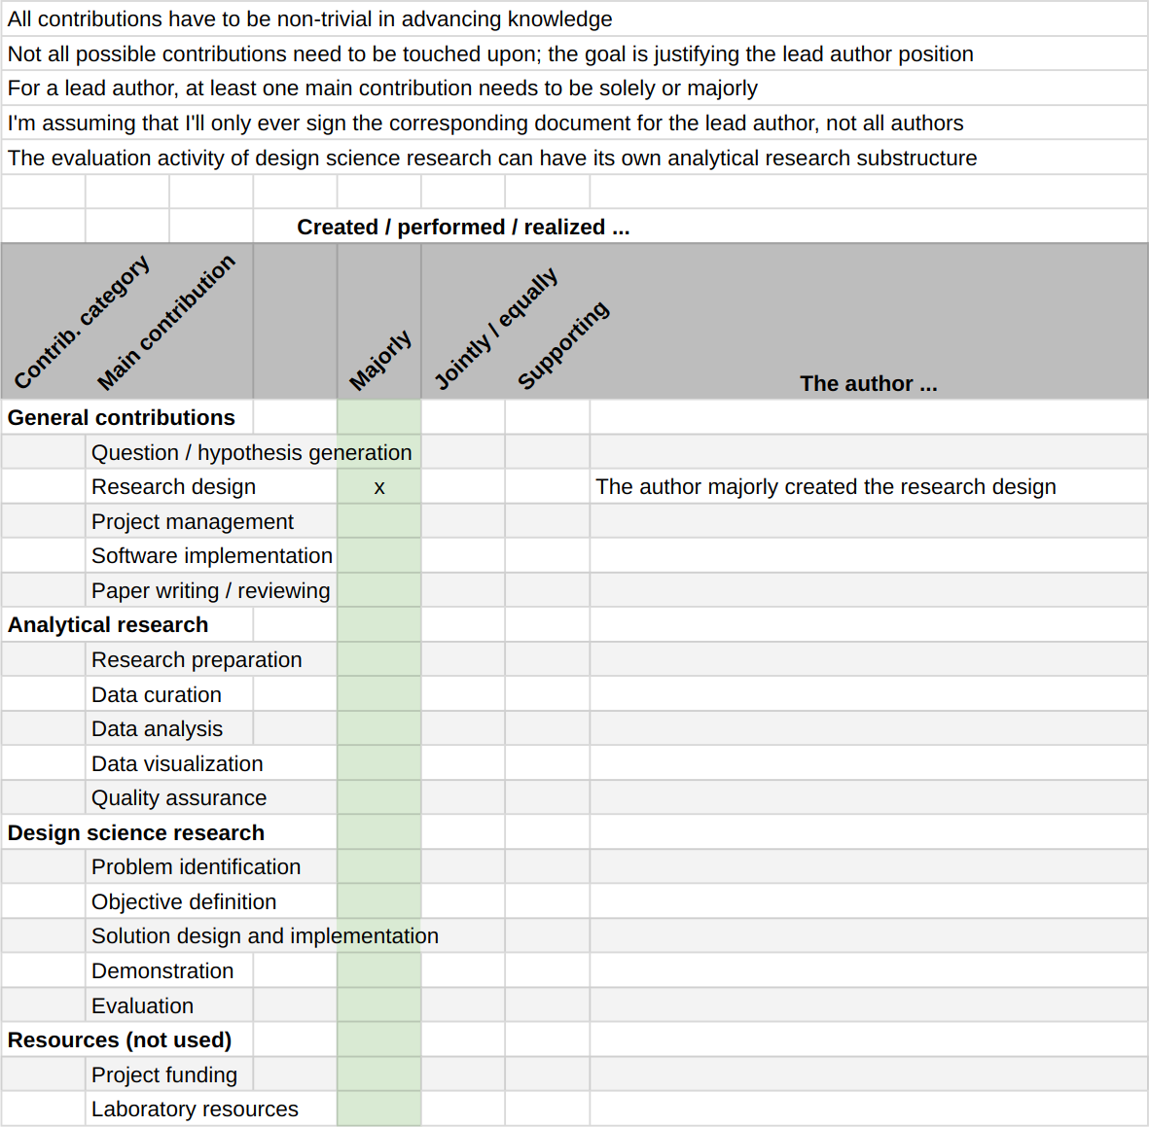
Rank Ordering Intellectual Contributions
Use a contribution model
To first account for contributions
Then to rank-order them

Slide 15
3. Abstract
The purpose of an abstract is to
Draw readers in
Summarize the article
Most readers are lost in the abstract

Slide 16
Patterns for Abstracts
(1) Open source software is available for free and many companies use it in their software. (2) However, managers worry that open source is only a temporary phenomenon and will go away, leaving them with abandoned software components that nobody is maintaining. (3) This article analyses the growth of open source software. (4) We show that open source is alive and keeps growing. (5) Thus, open source is a sustainable phenomenon and managers can use open source software in their products.
One sentence each describing the
Context / domain
Research problem
Approach taken
Research results
Consequences of work
Kent Beck’s four sentence abstract
The problem
Why the problem is a problem
One “startling sentence”
Implications of findings
(1) Users of open source software worry that the open source phenomenon is not sustainable. (2)They hesitate to adopt open source software and miss out on its economic benefits. (3) This paper shows that open source is a sustainable phenomenon. (4) Thus, users should not worry but adopt and gain the benefits of open source software.

Slide 17
4. Introduction
The purpose of the introduction section is to
Keep drawing in the reader
Set expectations straight
Get going with the paper
Most readers’ belief is lost in the introduction

Slide 18
Structure of the Introduction Section
The introduction section
Extends the abstract
Contrasts most relevant work
Explicitly lists contributions of work
Summarizes the structure of the paper

Slide 19
The Claim to Contributions
You should claim your contributions,
explicitly, and
as precisely as you can
The contributions of this paper are:
An operational definition of how to measure open source project growth;
The assessment of past open source growth using a large sample representative of open source;
The now plausible prediction that open source software as a whole will keep growing in the future.

Slide 20
5. Related Work
A related work section surveys
Prior art you are building on
Relevant work (to yours)
Related work is identified through a literature survey
An ad-hoc literature survey
A structured literature review (see earlier lecture)

Slide 21
Prior Work
Prior work (art) is work you build on
You need it to perform your work
You need readers to understand so they can understand your work
Prior work does not compete with yours

Slide 22
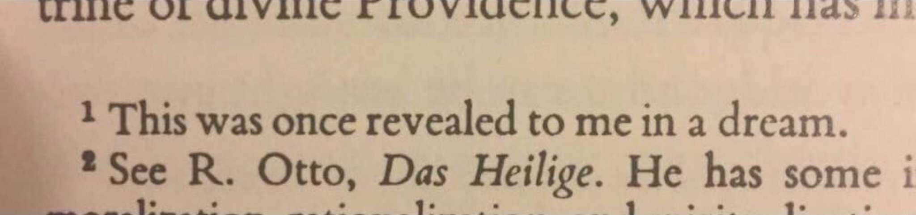
Not Appropriate Prior Work

Slide 23
Relevant Work (Trad. Related Work)
Relevant work is related in that
It may have attempted the same as your work
It may have gone alternative ways
You need to compare-and-contrast to show the relationship and difference
You compare to show how you relate
If the work is not related, it is irrelevant to your paper
You contrast to show how are different
If not different from yours, your work is not novel

Slide 24
Presentation Structure
You should structure related work by
Domains first
Application domain, technical domain, etc.
Then specialize within domain
From the more general to the more specialized work

Slide 25
6. Research Design
The research design section
Presents your research design, methods employed, etc.
Serves to convince reviewers and readers of (sufficient) rigor of work
The section is also known as
Approach or
Methods
The specifics depend on your research design

Slide 26
7. Research Results
The research results section
Presents the data you gathered, the results you derived
Convinces the reviewers and readers of relevance of your work
The specifics also depend on your research design

Slide 27
8. Discussion
The discussions section
Discusses your research results
Establishes (beyond the results section) their quality
The specifics depend on the type of research
In qualitative research, also often called discussion and limitations
Qualitative research needs
Two separate sections, one interpreting research results and one on
Limitations based on qualitative research quality criteria
In quantitative research, also often called threats to validity
Quantitative research needs
Less of a discussion section past the results section but most certainly a
Threats to validity section that discusses the results using quantitative research quality criteria

Slide 28
Structure of Limitations / Threats to Validity
Break down by relevant quality criterion
Feel free to choose relevant criteria beyond the core four
You should always put weaknesses / challenges into context
Explain their consequences

Slide 29
9. Conclusions
In the conclusions section you should
Reiterate the main contributions and their significance
Some readers jump from abstract to conclusions directly
Skip any outlook on future work that is on your mind

Slide 30
10. Acknowledgments
List all people and thank them who made a contribution that was relevant but
Not enough to make them an author of the article

Slide 31
11. Literature References
A literature reference is
A lookup key for the literature references section that
Identifies one entry of literature in the references section
The literature references section
Contains the literature referenced in your article
Each entry identifies one piece of external literature
If it contains additional recommended (not referenced) literature
It is called a bibliography

Slide 32
Common Formats for Literature References
Three common forms for a reference (key) to the literature (value)
Reference (key) | Referenced entry (value)
[27] | Spector, A. Z. 1989. Achieving application requirements. In Distributed Systems, S. Mullender, Ed. ACM Press. ACM, New York, NY, 19-33.
[Spe89] | Spector, A. Z. 1989. Achieving application requirements. In Distributed Systems, S. Mullender, Ed. ACM Press. ACM, New York, NY, 19-33.
Spector, A. Z. (1989). | Achieving application requirements. In Distributed Systems, S. Mullender, Ed. ACM Press. ACM, New York, NY, 19-33.

Slide 33
3. Final Research Theses

Slide 34
The Structure of Final Research Theses
There are two main options for the structure of final research theses
You follow the research article structure and blow it up to thesis size
You write a research article and then complement it with detail material
In the second case,
The first part should have research article size e.g. ten pages
The second part should contain the material that usually goes into a technical report

Slide 35
4. Academic Writing

Slide 36
First Rule of Successful Writing
First and foremost rule
Know your audience
Further best practices
Be brief and concise
Use active voice
Avoid weak wording
Avoid imprecise wording

Slide 37
Be Brief and Concise
(Attributed to) Mark Twain (November 30, 1835 – April 21, 1910):
“I didn’t have time to write a short letter, so I wrote a long one instead.”
Strunk and White (1918):
“Omit needless words.”
The internet (around 2015):
“tl;dr”

Slide 38
Example on Being Brief
Before:
“It is suggested to remove any dependency on prerequisite 3 in this experiment to not unduly restrict any possible outcome.”
After:
“It is suggested to remove any dependency on prerequisite 3 to not unduly restrict the outcome.”

Slide 39
Example on Being Concise
Before:
“It is suggested to remove any dependency on prerequisite 3 to not unduly restrict the outcome.”
After:
“It is suggested to remove requirement 3.”

Slide 40
Use Active Voice
Passive voice is
Unnecessarily lengthy
Often hides the actor

Slide 41
Example of Using Active Voice
Before:
“It is suggested to remove requirement 3.”
After:
“Drop requirement 3.”

Slide 42
Avoid Weak Wording
Weak wording
“We tried to…” (So what?)
“We believe…” (OK, why?)
“Try not. Do or do not. There is no try.”

Slide 43
Avoid Imprecise Wording
Imprecise wording
“Very efficient…” (How efficient?)
“Many occurrences…” (How many?)
Don’t leave your reader guessing

Slide 44
All Rules Break Down, Eventually
“A veterinarian prescribed antibiotics Monday for a camel that lives behind an Iberville Parish truck stop after a Florida woman told law officers she bit the 600 pound animal’s genitalia after it sat on her when she and her husband entered its enclosure to retrieve their deaf dog.” [1]
[1] See https://www.newyorker.com/magazine/2021/12/27/florida-woman-bites-camel

Slide 45
Summary
The research paper
Sections of a research paper
Final research theses
Academic writing

Slide 46
Thank you! Any questions?
dirk.riehle@fau.de – https://oss.cs.fau.de
dirk@riehle.org – https://dirkriehle.com – @dirkriehle

Slide 47
Legal Notices
License
Licensed under the CC BY 4.0 International license
Copyright
© Copyright 2022 Dirk Riehle, some rights reserved

